Slide 1
CYCLISTIC BIKE SHARE ANALYSIS
-Harish Thulasiraman

Slide 2
CONTENTS
Introduction & Objective
Dataset Overview
Data Cleaning & Preprocessing
Exploratory Data Analysis (EDA) Overview
Visualizations & Insights
Challenges
Conclusion

Slide 3
INTRODUCTION & OBJECTIVE
This case study explores world trip data from the Cyclistic bike-sharing program in Chicago during 2019.
The objective was to analyze user behavior patterns - such as trip duration, peak usage times, age groups, and gender distribution - using Python and data visualization.

Slide 4
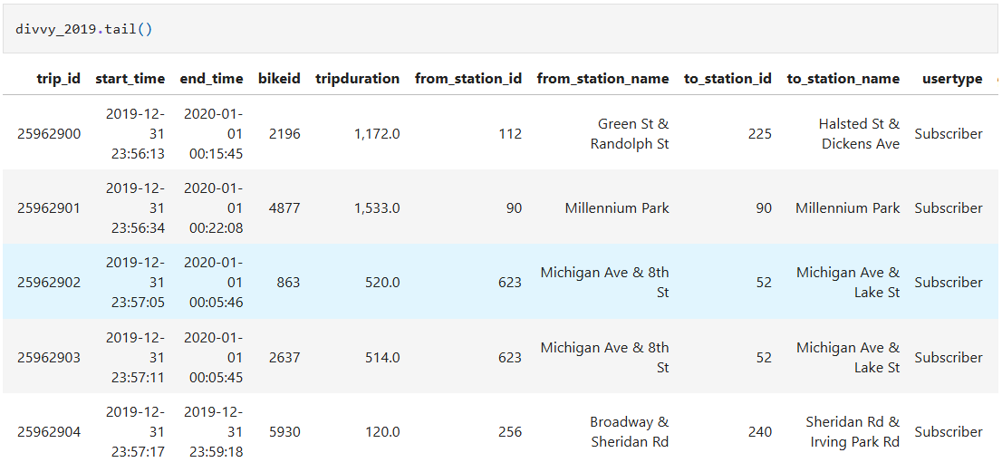
Dataset Overview

Slide 5
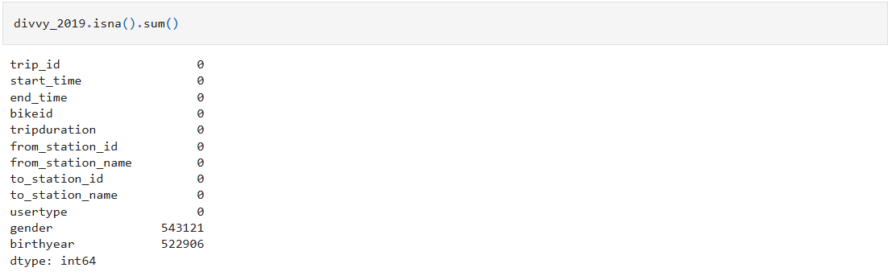
Data Cleaning & Preprocessing

Slide 6
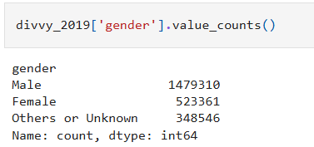
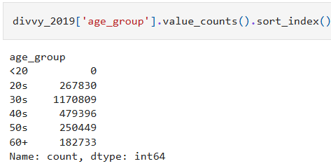
Exploratory Data Analysis (EDA) Overview

Slide 7
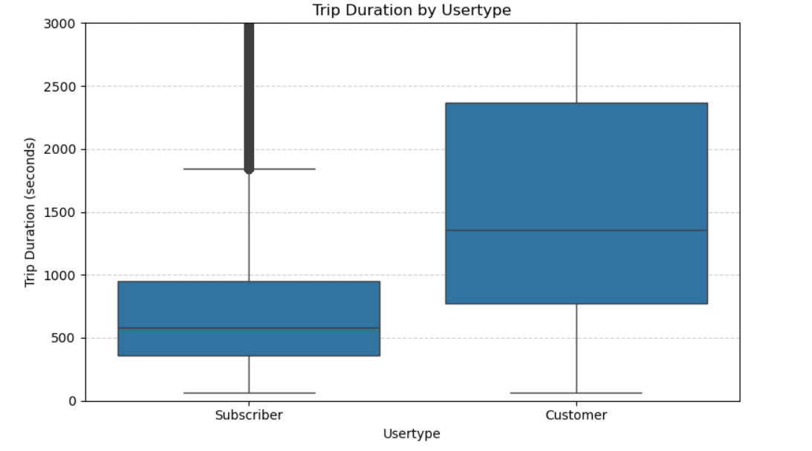
Visualizations & Insights

Slide 8
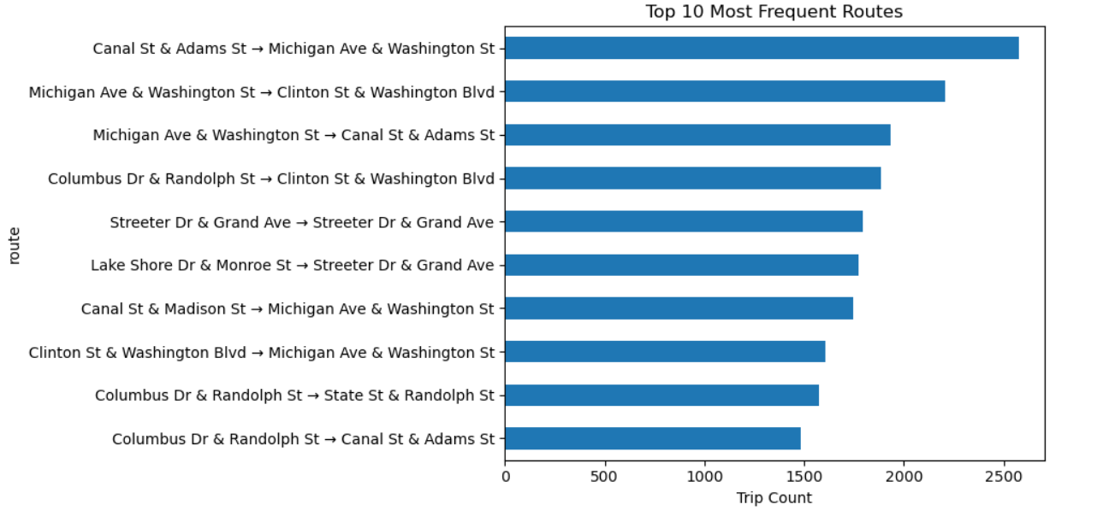
Visualizations & Insights

Slide 9
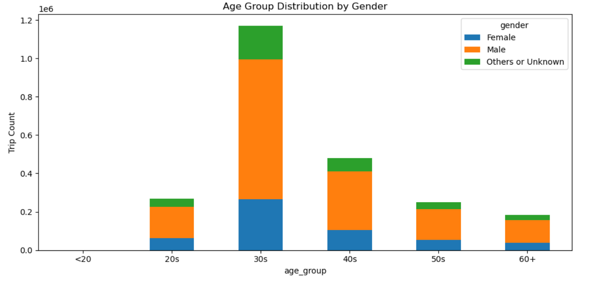
Visualizations & Insights

Slide 10
TOP INSIGHTS
Most users were Subscribers
Over 75% of trips were taken by subscribers rather than casual customers.
Males took more trips than females
Male riders accounted for the majority of all recorded trips, especially among subscribers.
Peak usage occurred during weekday rush hours
Trips spiked around 8–9 AM and 5–6 PM, suggesting heavy commuter use.
Casual riders had longer average trip durations
Customers (non-subscribers) took longer rides on average, possibly for leisure or exploration.
Most riders were aged 25–45
The most active age group fell within this range, with the average rider born in the 1980s.

Slide 11
CHALLENGES
Large file size and Excel limitations:
The full dataset (3M+ rows) was too large for Excel, requiring sampling and optimized CSV handling.
Missing and inconsistent data:
Key columns like gender and birthyear had many null values, requiring thoughtful cleaning and imputation.
Mixed data types:
Some numeric fields were read as strings (e.g., 'tripduration' with commas), causing type conversion issues.
Datetime conversions and feature extraction:
Converting strings to datetime format and extracting hours, weekdays, and months required multiple steps and validation.
Visualizing large data:
Saving high-quality charts and making them GitHub-friendly (small size, readable format) took extra care.

Slide 12
Conclusion
This case study provided meaningful insights into Divvy bike-sharing behavior through exploratory data analysis using Python.
By cleaning and transforming over 2.4 million trip records, we uncovered patterns in rider types, trip durations, and age-based usage. Subscribers used bikes more frequently for shorter durations, while casual customers rode less often but for longer periods.
This project reinforced the importance of thoughtful data preprocessing and visualization in drawing actionable conclusions from large-scale real-world datasets.

Slide 13
Thank you for reviewing my case study!
Harish Thulasiraman
🔗 LinkedIn
🔗 GitHub

